Slide 1





TECHNOVATE’25
PROBLEM STATEMENT : Manual attendance systems are time-consuming and prone to errors, leading to inefficiency and potential discrepancies in attendance records. A more efficient, automated solution is needed.
PS ID : TV-HW-02
PS CATEGORY : Hardware + Software
TEAM NAME : ByteRight
TEAM ID : TV-T-30
TEAM MEMBERS : J. Meghana
Ch. Jithender Sai
E. Vaishnavi
B. Akhil

Slide 2
SOLUTION OVERVIEW
Hackathon
logo
We propose a Smart Attendance System using RFID that enables students to register attendance through RFID tags. These tags are scanned by an RFID reader connected to a microcontroller (Arduino), which logs the attendance with a timestamp. Data is stored in Excel and displayed on an LCD for confirmation.
Eliminates manual errors
Saves time with instant attendance logging
Provides real-time and historical reports
Contactless, hence hygienic and efficient

Slide 3
INNOVATION OF SOLUTION
1. Integrates LCD display to give real-time confirmation to users after scanning.
2. Can be customized to trigger alerts for late arrivals or absenteeism.
3. Low-power design ensures energy-efficient operation, ideal for continuous use.
4. Offers offline functionality attendance can still be logged without internet and synced later.
5. Enhances security by uniquely identifying each individual via RFID UID.

Slide 4
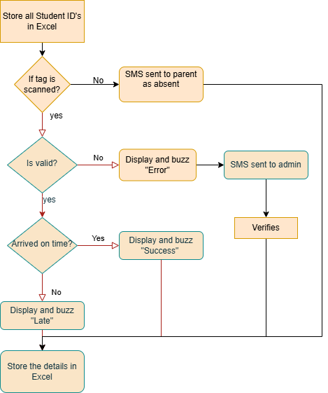
TECHNICAL APPROACH
TECHNOLOGIES:
Microcontroller: Arduino Uno
Sensors: RFID Reader (RC522), RFID Tags
Programming Language: Python
Database: Excel File

Slide 5
IMPACT & BENEFITS
Hackathon
logo
Educational institutions can track student presence with high accuracy.
Teachers and administrators save significant time and effort.
BENEFITS OF THE SOLUTION
Social: Reduces teacher workload, enhances transparency
Economic: Minimizes need for paper-based systems
Environmental: Paperless approach contributes to sustainability
Technical: Easy to implement, scalable, and cost-effective

